Slide 1




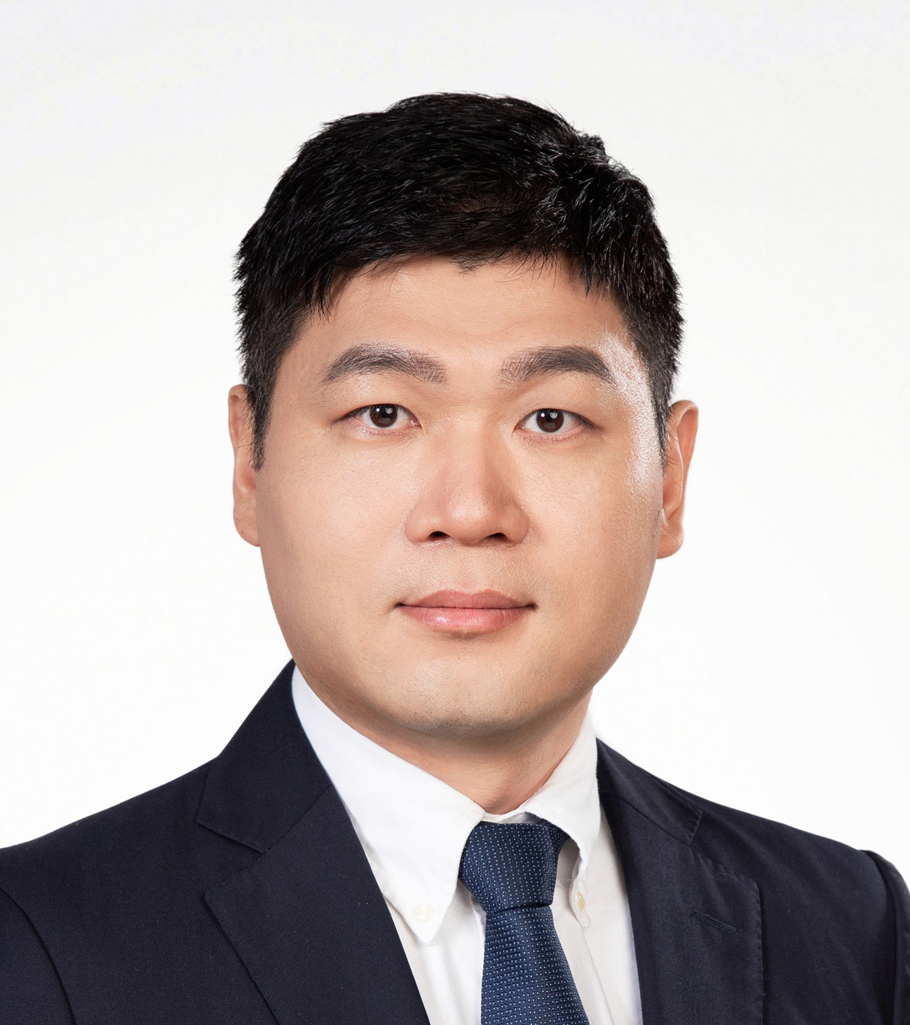



RNA-mediated regulation in Listeria monocytogenes：from virulence regulation to antibiotic resistance
Time (CET): 2025-06-13 10:00
Time (CST): 2025-06-13 16:00
Zoom ID: 835 3807 3738
Passcode: 123456
Zoom meeting link: https://us06web.zoom.us/j/83538073738?pwd=wDyK70IkEvRvVbSSC0eHPEgb3RjZBV.1
Tencent metting ID: 431-343-612
Bilibili：https://live.bilibili.com/26427894
Prof. Pascale Cossart
Emeritus Professor at the renowned Pasteur Institute in Paris,
Corresponding member, French Academy of Sciences
Member, German Academy of Sciences Leopoldina
Foreign member, Royal Society of London
Member of the European Academy of Microbiology
Foreign Member of the National Academy of Medicine (NAM), USA
Member, American Academy of Microbiology
Associated member of the Académie Nationale de Pharmacie, Paris
Commandeur of the Ordre national du Mérite.
Abstract:
The bacterial pathogen Listeria monocytogenes is well known for its amazing capacity to infect cells and tissues. Listeria is also a paradigm in RNA-mediated regulation. First, it coordinates expression of its major virulence factors by a thermosensor. In addition, it is a champion in ribo-regulation. Some riboswitches regulate the synthesis of non-coding RNAs in an original way to control metabolite utilization in the gut. Other riboregutors provide antibiotic resistance in presence of antibiotics. We also discovered a novel type of regulation by excludons. The talk will illustrate some of these fascinating RNA-mediated regulations.
HOST＆PANELISTS
Host: Zhichao Miao
Guangzhou Laboratory
Guangzhou Medical University
Jinkai Wang
Sun Yat-sen University
Zongfu Wu
Nanjing Agricultural University
Lin Huang
Sun Yat-sen University
Sponsors

Slide 2
从毒力调节到抗药性机制：
单核增生李斯特菌中RNA-介导调控的多重角色
北京时间: 2025-06-13 16:00
Zoom 会议号: 835 3807 3738
密码: 123456
Zoom 会议链接: https://us06web.zoom.us/j/83538073738?pwd=wDyK70IkEvRvVbSSC0eHPEgb3RjZBV.1
腾讯会议号： 431-343-612
B站：https://live.bilibili.com/26427894
Pascale Cossart 教授
巴斯德研究所前所长
法国科学院院士、德国科学院院士、美国科学院院士、
欧洲科学院院士、英国皇家学会院士
法国国家功绩勋章获得者
摘要：
单核细胞增生李斯特菌（Listeria monocytogenes，以下简称李斯特菌）不仅以其卓越的细胞和组织侵袭能力而闻名，更已成为解析RNA介导基因调控的经典模型：该菌借助温度感受子精确协同调节主要毒力基因的表达，并凭借丰富的“核糖调控（ribo-regulation）”手段脱颖而出——多种核糖开关通过独特机制调控非编码RNA的合成，在肠道环境中精细分配代谢物；特定核糖调控元件则在抗生素存在时赋予细菌耐药性。我们近期鉴定的全新RNA调控模式 “excludon” 进一步拓展了对李斯特菌基因表达层级的认识。本次分享将系统阐述这些引人入胜的RNA介导调控策略，展示其在病原菌生物学与代谢适应中的关键作用。
主持人＆嘉宾
主持人：苗智超
广州实验室
广州医科大学
王金凯
中山大学
吴宗福
南京农业大学
黄林
中山大学
赞助商

